Slide 1
Data Efficient Machine Learning in Healthcare
Atharv Savarkar (180010015)
Guide: Prof. Ganesh Ramakrishnan (CSE)
Co-Guide: Prof. Kshitij Jadhav (KCDH)

Slide 2
Section 1 - PET-CT Analysis
Automated feature extraction algorithm for prognostic analysis of Hodgkin Lymphoma patients

Slide 3
Introduction
ML predictive models in medical domain require high quality features.
Feature extraction done using pre-trained model might not be clinically relevant.
Dedicated FE algorithm is important while dealing with multi-modal data.

Slide 4
Prognostic analysis for HL
Hodgkin Lymphoma (HL) cancer is spread in lymph nodes throughout the body.
Treatment ABVD, BEACOPP are suggested based on clinician’s opinion.
ML techniques can be used to assist clinician in this process.
Multimodal data (PET-CT, WSI) can be taken into consideration for prediction.

Slide 5
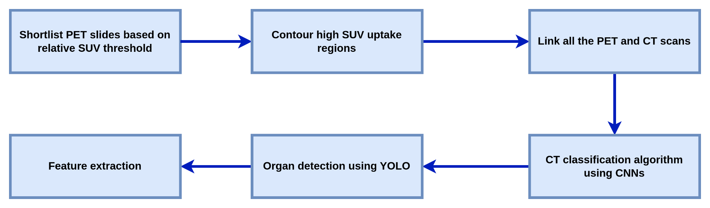
Project Flowchart

Slide 6
Shortlisting PET scans for analysis
High SUV signifies either tumour or regions of high metabolism.
Most of the important features can be extracted from these regions.
Shortlisting leads to less computation, and in turn less errors.
Gives more intuitive understanding of regions where tumour is more spread.

Slide 7
Shortlisting Algorithm
SUV is calculated for each slide in PET scan.
Max of these slides is computed i.e. SUVmax for patient.
Predefined threshold (0.8-0.9) is used to shortlist slides which have
SUV > threshold * SUVmax
These slides are further used for computation.

Slide 8
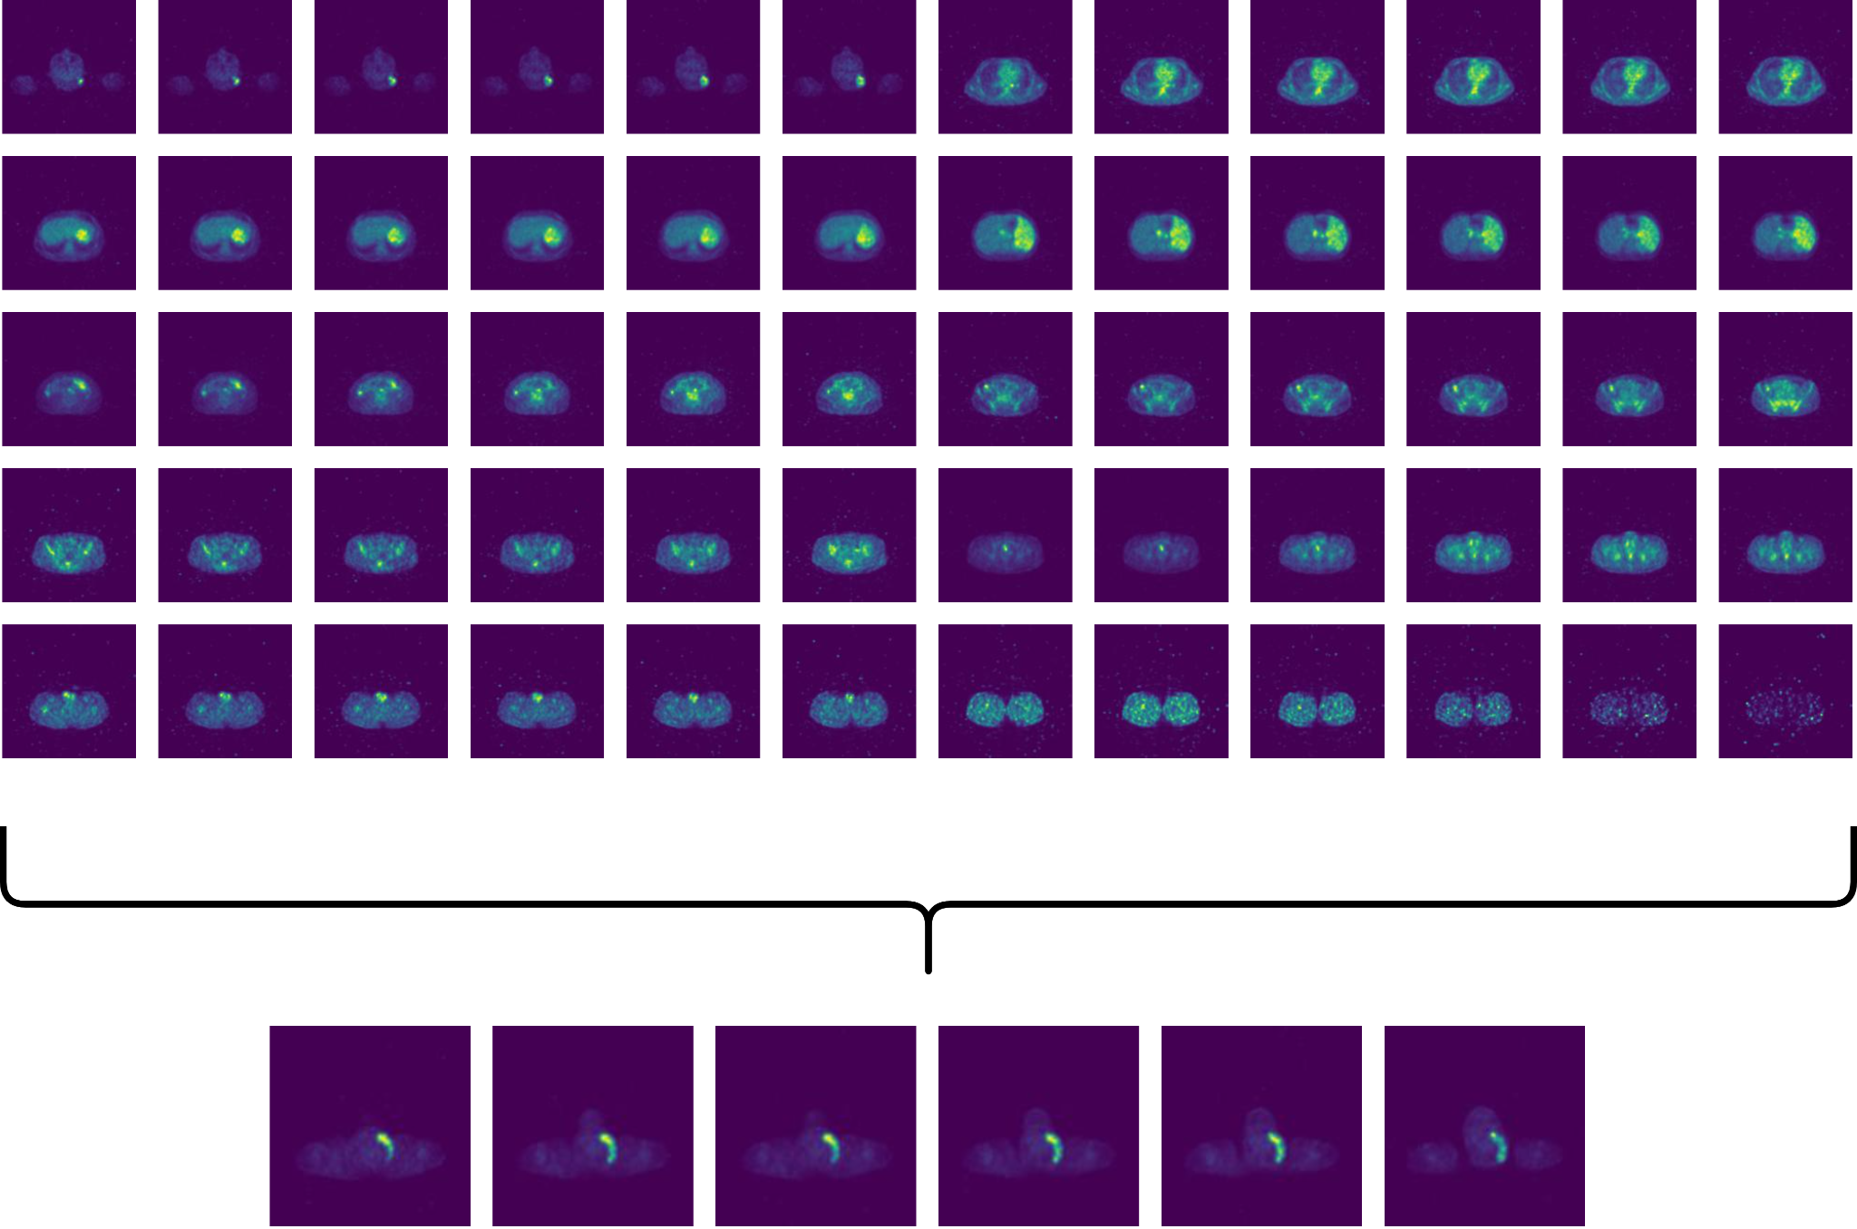
Shortlisting Example
Figure 1: Selected PET scans for analysis from pool of scans

Slide 9
Project Flowchart

Slide 10
Contouring high SUV uptake regions
High SUV signifies either tumour or regions of high metabolism.
Shape and size of this tumour can be used to extract features like
TLG (Total lesion glycolysis)
MTV (Metabolic tumor volume)

Slide 11
Contouring Algorithm
Inbuilt OpenCV functions are used to create contours around high intensity regions which signifies high SUV.
Area and other shape related parameters can be easily calculated from this computed data.

Slide 12
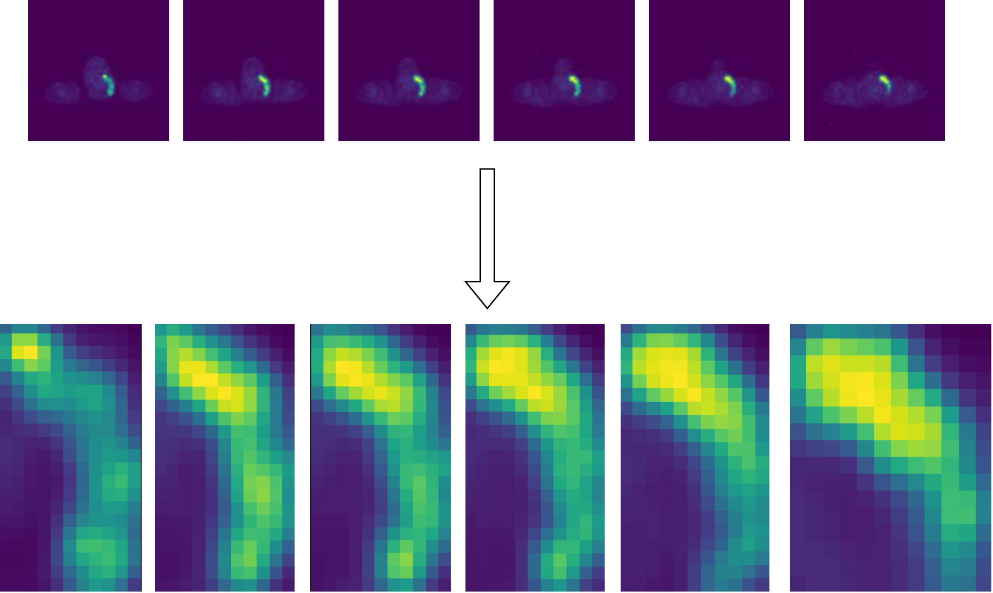
Contouring Example
Figure 2: Extracted contours from PET slides

Slide 13
Project Flowchart

Slide 14
PET-CT Linking
CT scans can be used to classify broad region of tumour.
Easy to differentiate regions for CT scans compared to PET scans
Organ detection can be done on CT scan (not effective on PET scan).

Slide 15
PET-CT Linking Algorithm
Number of slides for CT scans and PET scans are not same.
SlideLocation parameter in DICOM file can be used to find out CT scan closest to given PET scan and vice-versa.
This creates python dictionary linking all the PET and CT scans.

Slide 16
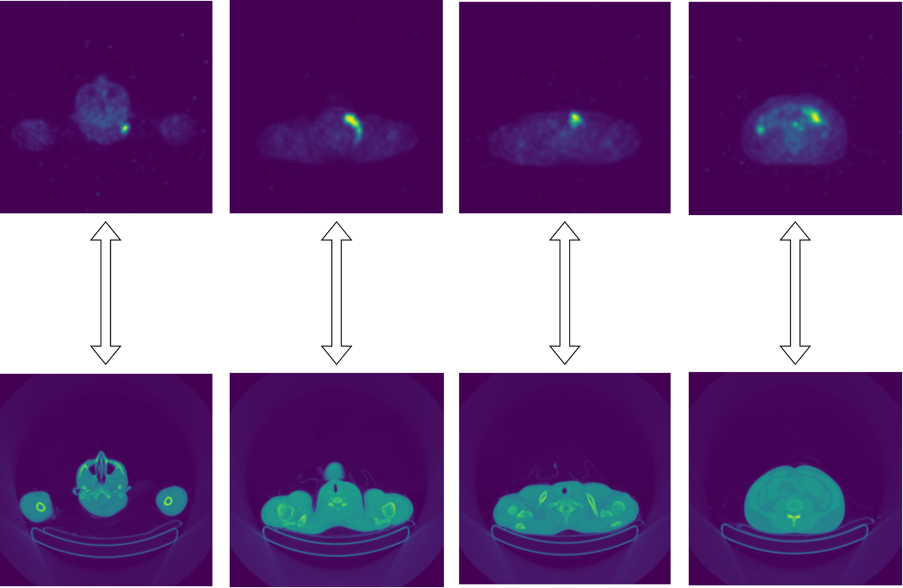
PET-CT Linking Example
Figure 3: PET-CT Linking

Slide 17
Project Flowchart

Slide 18
CT Classification
CT scans are classified into 7 different major sections that are head, neck, upper-thorax, lower-thorax, abdomen, pelvis, legs.
Organ detection can be done once we classify CT scans

Slide 19
CT Classification Algorithm
Deep learning model ResNet18 is trained on classified data for training
Hyperparameters are tuned to get maximum accuracy
Model is deployed for prediction

Slide 20
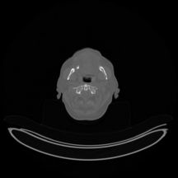
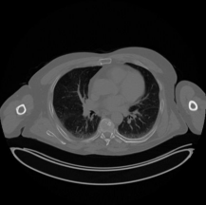
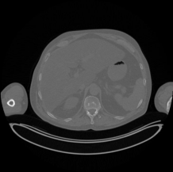

CT Classification Example
Head
Thorax
Abdomen
Legs
Figure 4: CT Classification

Slide 21
Project Flowchart

Slide 22
Organ Detection
SUV uptake in each nodal region and organ can be used as feature that is clinically as well as prognostically significant
Spread of tumor in organs can be detected and monitored

Slide 23
Organ Detection Algorithm
Decide on which organs needs to be identified in each region (nodal locations as per clinical recommendations)
Get some of these organs labelled
Train and fine-tune YOLO model for detection
Deploy for computation

Slide 24
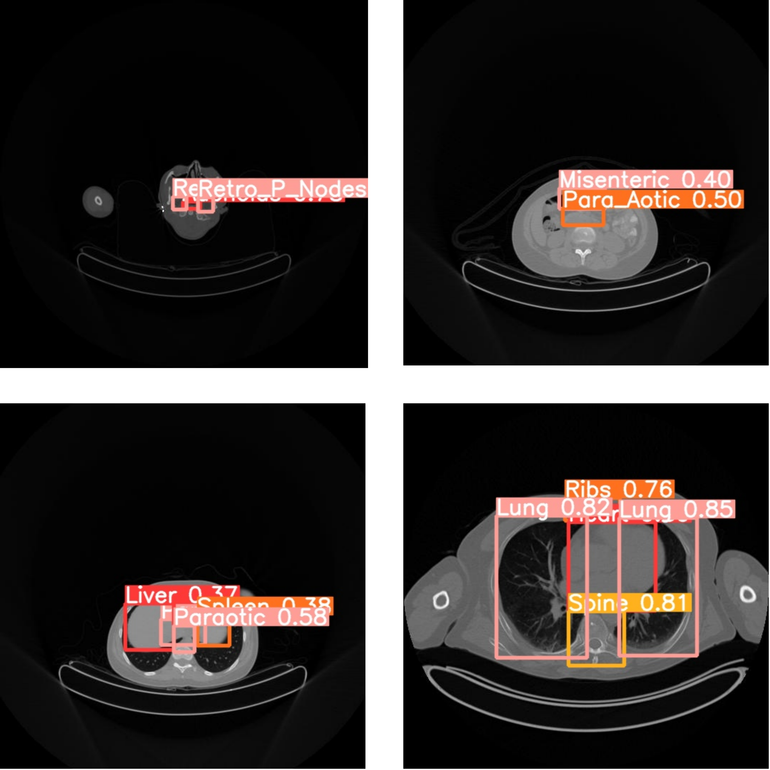
Organ Detection Example
Figure 5: Organs and node location detection using YOLO

Slide 25
Project Flowchart

Slide 26
Feature extraction
Aggregating all the computed info till now features can be extracted
Some of the features can be SUV_{max}, TLG, etc
This along with features related to patient history can be further fed into prediction model (e.g. XGBoost) to get final results

Slide 27
Section 2 - DOGMAS
Diversity induced subset selection based Generation for
medical imaging in data constrained setting

Slide 28
Introduction
Deep learning models are widely used in medical domain for analysis and automation
Models are not feasible to deploy in resource constrained settings due to:
Requirement of huge amounts of labelled data
Computationally expensive to train and test

Slide 29
Need to reduce labelling cost
Difficult for layman to label the dataset
Need for an domain expert -> more labelling cost
E.g. In case of cancer related studies radiologist needs to label images
Labelling huge chuck to create dataset might not be financially feasible for researchers undertaking the study
Generally a huge chunk of unlabelled data is available

Slide 30
Submodular Functions (DECILE-Submodlib)
Submodlib library on DECILE (Data Efficient Machine Learning) platform provides with a huge number of submodular functions
These functions have capability to select data points from huge pool of unlabelled dataset based on diversity, representation and many other attributes

Slide 31
Diverse Subset Selection
Submodular functions have proven their power in medical domain
Log-Determinant function can be used to select most diverse data points
Training model on these data points significantly boost the testing accuracies

Slide 32
Generative Models - wGAN
Generative models have a huge potential in medical domain
Fake images can be created which look exactly similar to the original distribution
Traditional GANs tend to overfit and crash while training

Slide 33
Generative Models - wGAN
wGANs are recent improvements over normal DCGANs which are capable of generating high quality images
These models use Wasserstein Distance instead of KL Divergence as loss function

Slide 34
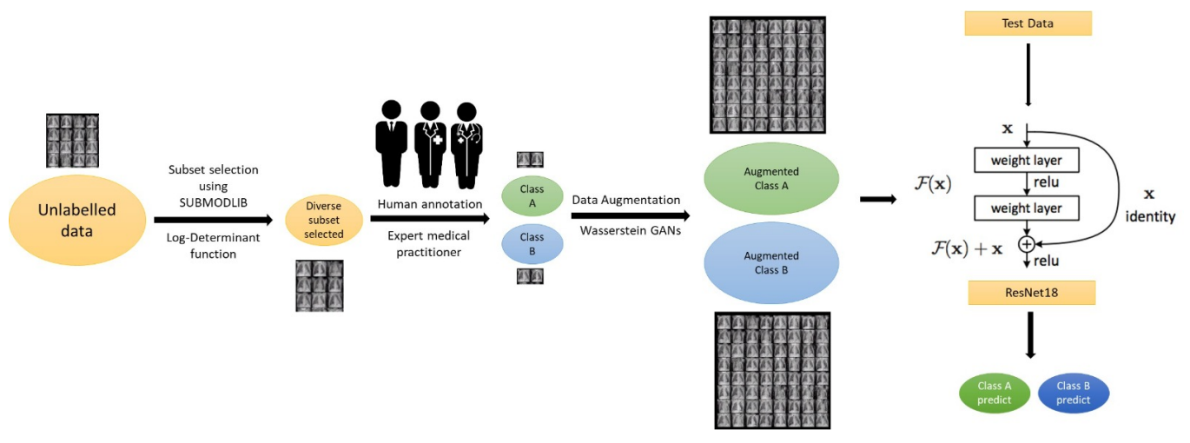
Our Approach
Figure 6: Pictorial presentation of intelligent subset selection driven approach followed by GANs data augmentation

Slide 35
Datasets and Results
We have applied our approach on 4 datasets and got consistent results
DermaMNIST
PneumoniaMNIST
BreastMNIST
APTOS-2019
All datasets were converted to binary classification settings

Slide 36
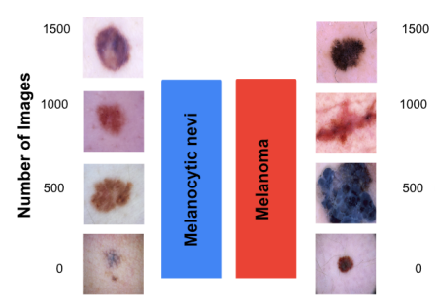
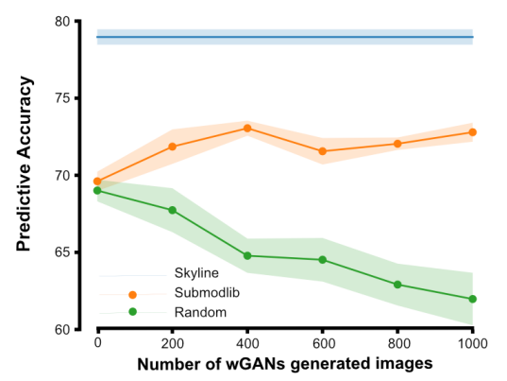
DermaMNIST Results
Figure 7: DermaMNIST dataset and results

Slide 37
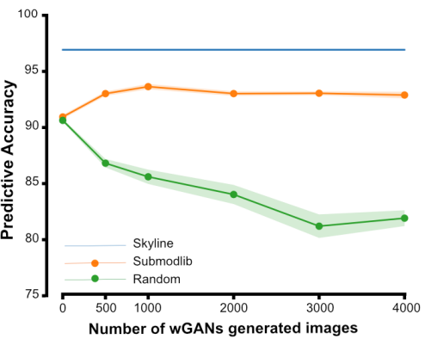
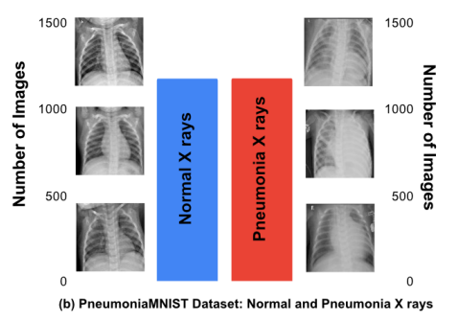
PneumoniaMNIST Results
Figure 8: PneumoniaMNIST dataset and results

Slide 38
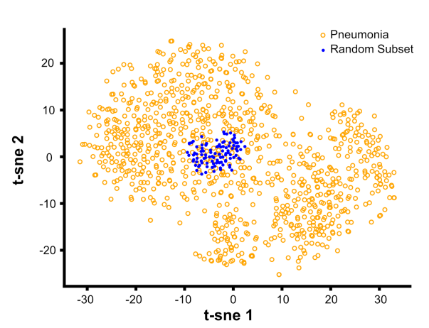
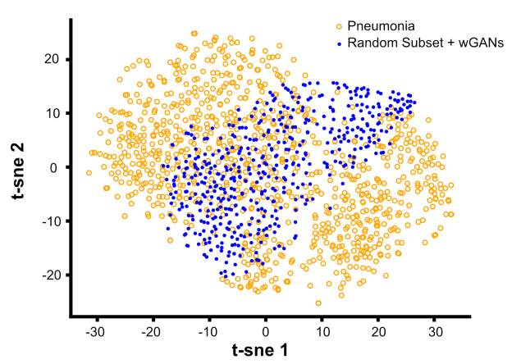
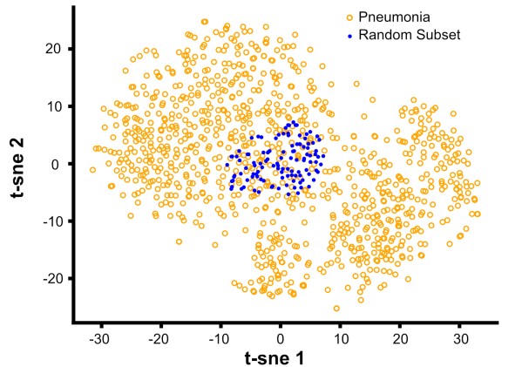
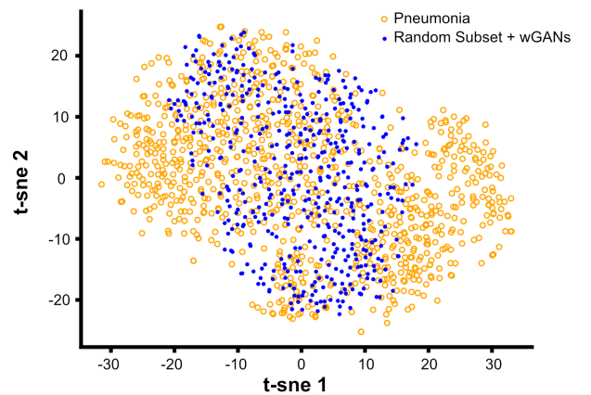
t-SNE Representation
Random Subset Selection
wGANs on Random Subset
Diverse Subset Selection
wGANs on Diverse Subset
Figure 9: t-SNE representation of selection and generated images

Slide 39
Conclusion
Diverse subset selection help model to train better features
Generative model can generate data points spanning original distribution when trained on diverse subset of points
Submodular functions along with wGANs can be used in data constrained settings

Slide 40
Thank You !

